Slide 1
Product development for quality monitoring of recycled wastewater
Amrutha Mupparaju

Slide 2
Introduction
The increasing demand for water and the limited supply of freshwater have made the effective management of wastewater critical
The potential impact on the environment, the presence of pollutants in wastewater can pose a significant risk to public health
Traditional methods of monitoring wastewater quality have been time-consuming, labour-intensive, and often do not provide real-time data

Slide 3
Motivation
The motivation behind the product development for quality monitoring of recycled wastewater stems from the increasing demand for sustainable water resources and the need to ensure the safety, reliability, and compliance of recycled wastewater.
By monitoring the quality of recycled wastewater, we can protect the environment, safeguard public health, meet regulatory requirements, optimize water management, and enhance the acceptance and perception of recycled water as a valuable resource

Slide 4
OBJECTIVE
The main objective of this project is to develop a system for quality monitoring of recycled wastewater using TDS, turbidity, and pH sensors, with the data displayed on an LCD screen

Slide 5
Sub-Objectives
Design and construct a robust and reliable monitoring system that can accurately measure the TDS, turbidity, and pH levels in recycled wastewater.
Develop a user-friendly interface on the LCD display to provide real-time readings of the water quality parameters.
Implement calibration techniques to ensure accurate and precise measurements by the sensors.

Slide 6
LITERATURE SURVEY
S.NO​ | AUTHORS NAME(S)​ | YEAR OF PUBLICATION​ | FULL TITLE OF PAPER ​ | INFERENCE​ | OPEN PROBLEMS​
1.​ | M. Kumar, T. Singh, M. K. Maurya, A. Shivhare, A. Raut and P. K. Singh ​ | 2023 | "Quality Assessment and Monitoring of River Water Using IoT Infrastructure," ( IEEE Internet of Things Journal) | pH sensors can be used to measure the acidity or basicity of the water pH sensors can be connected to a cloud-based platform that provides real-time data on pH levels. The platform can also be programmed to trigger alarms or alerts if pH levels fall outside of the desired range | An IoT-based system is limited by its coverage area, and it may not be feasible to install sensors and devices in all rivers and water bodies
2. | Qi Song and Feng Luan and Zhan Shi and Taoren Li and Mingquan Wang | 2020 | "Design of Turbidity Remote Monitoring System Based on FX-11A Optical Fiber Sensor"( IEEE prognostics and health management ) | Turbidity sensors can be integrated into an IoT system to enable real-time monitoring of turbidity levels, providing operators with timely information to adjust the treatment process and ensure optimal treatment efficiency | It is affected by factors such as temperature, pressure, and the presence of air bubbles in the water. This can lead to inaccurate readings

Slide 7
LITERATURE SURVEY
S.NO​ | AUTHORS NAME(S)​ | YEAR OF PUBLICATION​ | FULL TITLE OF PAPER ​ | INFERENCE​ | OPEN PROBLEMS​
3. | Jayanthi G, Mathumitha N; Swathy S, Aaradhika S | 2020 | Smart Monitoring and Control of Water Filtration System Using IOT,” International Conference on Power, Energy, Control and Transmission Systems (ICPECTS) | Before and after purification process TDS sensor 1 and TDS sensor 2 are same, then a message will be sent to the consumer and the retailer | The system requires regular maintenance and updates to ensure smooth operation and prevent system failures. This may require additional time, effort, and resources from the users
4. | Bondan Suwandi, Yuki Istianto, Budi Nugroho, Nashrullah Taufik, Siswayudi Azhari | 2022 | Development of a Low-Cost TDS Sensor Using an Electric Plug with The Curve Fitting Method Approaches," ( International Conference on Radar, Antenna, Microwave, Electronics, and Telecommunications (ICRAMET)) | Measure the concentration of dissolved solids in the wastewater. TDS sensor calibrates and maintenance to ensure accurate readings | limited information provided about the experiment setup, calibration procedures, and the data analysis method used

Slide 8
LITERATURE SURVEY
S.NO​ | AUTHORS NAME(S)​ | YEAR OF PUBLICATION​ | FULL TITLE OF PAPER ​ | INFERENCE​ | OPEN PROBLEMS​
5. | A. Porwal, S. K. Mishra, A. Kela, G. Singh, M. Panchal and A. Jain ​ | 2022 | "Prediction and Prevention of Water Pollution by Industries using IoT based Monitoring System," 2022 IEEE 11th International Conference on Communication Systems and Network Technologies (CSNT) | Real-time insights into the data sent by each device in the device-network. Real time alerts are notified in the phone itself and necessary actions can be taken if needed. | IoT cloud infrastructure and services can be expensive. IoT devices generate a massive amount of data, which needs to be processed, analyzed, and stored
6. | M. Salem, M. S. Saraya and A. M. T. Ali-Eldin | 2022 | "An Industrial Cloud-Based IoT System for Real-Time Monitoring and Controlling of Wastewater, "IEEE Access" | A cloud-based architecture for the system, which enables remote monitoring and control of wastewater treatment plants. The system utilizes cloud-based databases to store and process data from the sensors | The system's cloud-based architecture relies heavily on internet connectivity. If the internet connection is slow or unreliable, the system's performance may be affected, leading to potential downtime or inaccurate monitoring

Slide 9
LITERATURE SURVEY
S.NO​ | AUTHORS NAME(S)​ | YEAR OF PUBLICATION​ | FULL TITLE OF PAPER ​ | INFERENCE​ | OPEN PROBLEMS​
7. | R. M. Kingsta, A. S. Saumi and P. Saranya, | 2019 | Design and Construction of Arduino Based pH Control System for Household Wastewater Reuse | This paper proposes an automatic system that treats the household wastewater to obtain optimum pH which is suitable for crop irrigation. | Water pH is much important for crop management as it affects the solubility of fertilizers, and the efficacy of insecticides and fungicides .Generally, the higher the water pH, the lower the solubility of materials.

Slide 10
Block diagram
Arduino
TDS
sensors
LCD
Turbidity
PH
Power supply

Slide 11
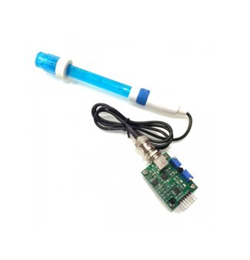
Components
PH sensor : pH is the measure of the relative amount of free hydrogen and hydroxyl ions in the water. Water that has more free hydrogen ions is acidic, whereas water that has more free hydroxyl ions is basic.
The range goes from 0 to 14, with 7 being neutral. pH of less than 7 indicates acidity. whereas pH of greater than 7 indicates a base

Slide 12
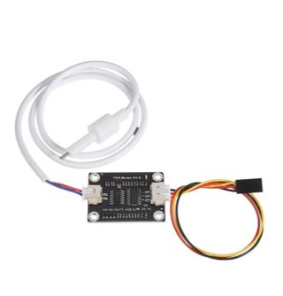
TDS
TDS : Total dissolved solids (TDS) are the amount of organic and inorganic materials, such as metals, minerals, salts, and ions, dissolved in a particular volume of water
Total dissolved solids (TDS) is measured with the unit parts per million (ppm) or milligrams per litre (mg/L)

Slide 13
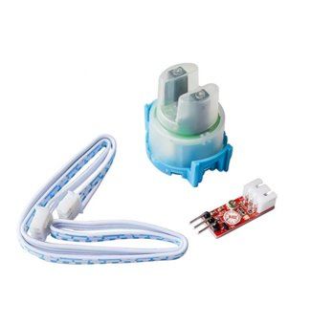
Turbidity
Turbidity: Turbidity is a measure of the degree to which the water loses its transparency due to the presence of suspended particulates. The more total suspended solids in the water, the murkier it seems and higher the turbidity.
The materials that causes water to be turbid include clay, silt, very tiny inorganic and organic matter, algae, dissolved coloured organic compounds
Units: Nephelometric Turbidity Unit

Slide 14
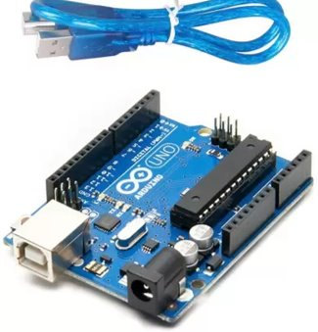
Arduino UNO
It is used to interface with various sensors installed in the wastewater treatment plant and collect data on water quality, temperature. The collected data can be transmitted to the cloud server for processing and analysis

Slide 15
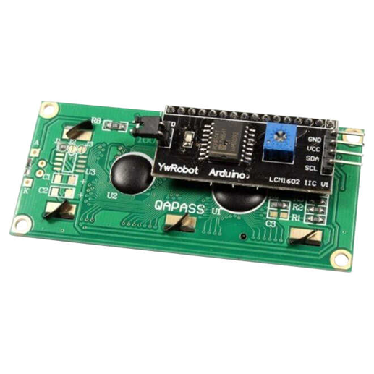
LCD
A liquid crystal display (LCD) with an Arduino to provide a user interface. Liquid crystal displays (LCDs) are a commonly used to display data in devices such as calculators, microwave ovens, and many other electronic devices

Slide 16
Reference values
 | Drinking water | Gardening | Rest rooms
TDS | Below 500 ppm | 500 to 1500 ppm | 1000 ppm
PH | 6.5 to 8.5 | 6.0 to 7.5 | 6.5 to 9.0
Turbidity (NTU) | Below 5 NTU | Below 50 NTU | Below 50 NTU

Slide 17
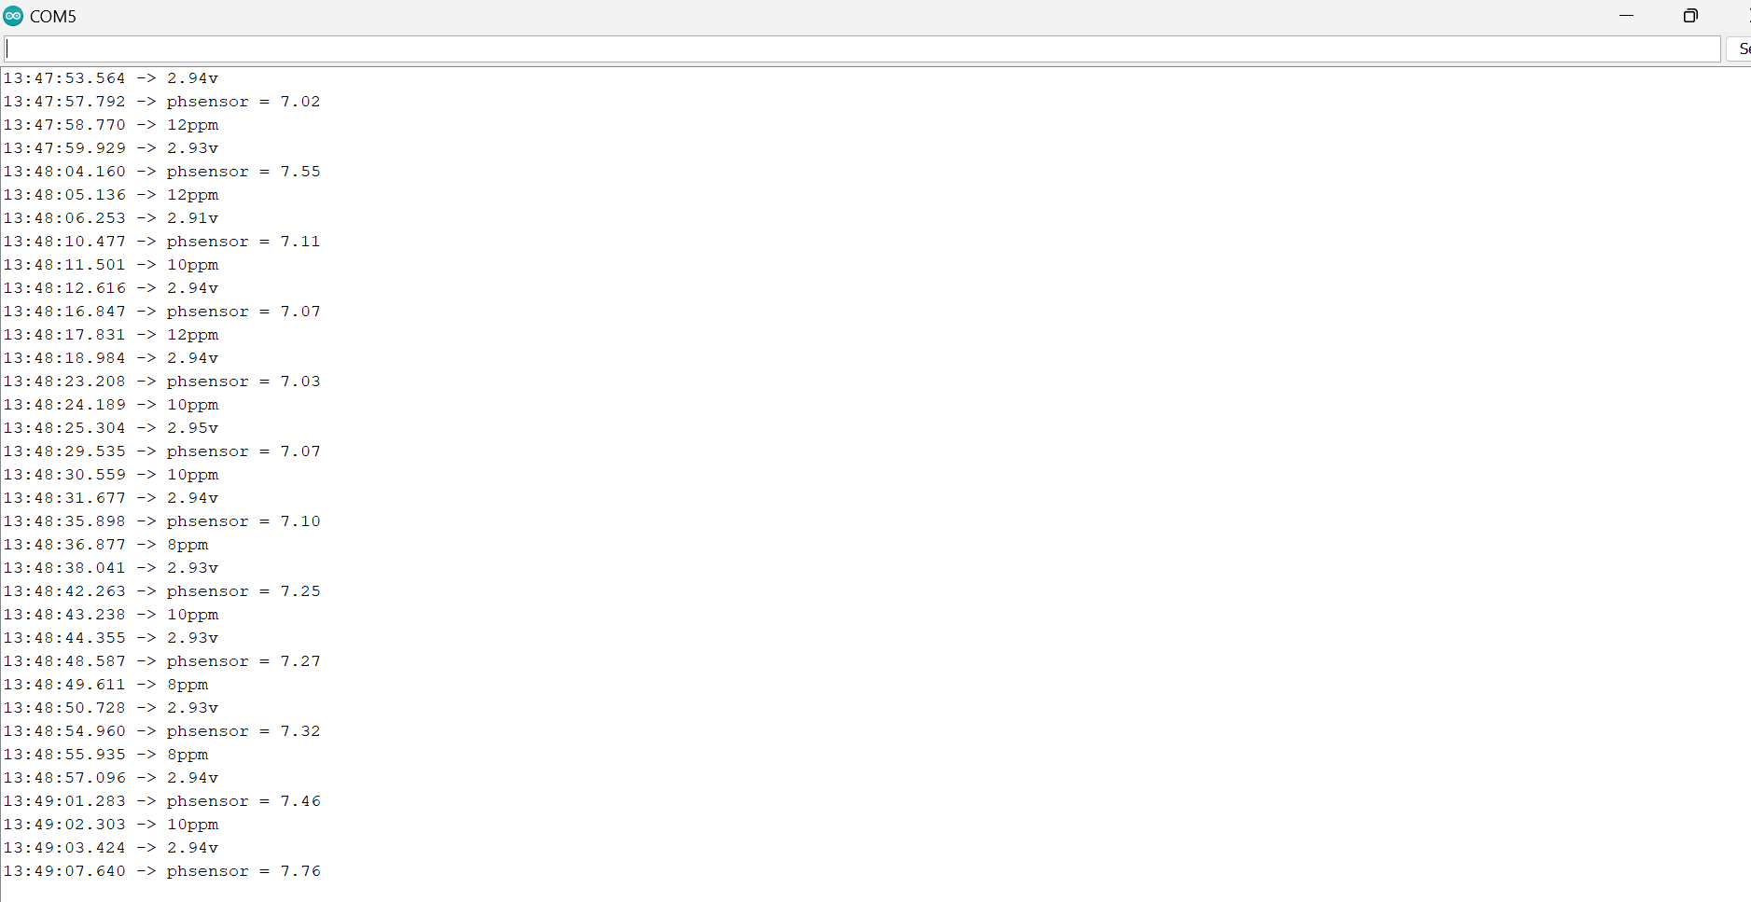
Result

Slide 18
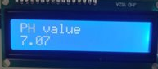
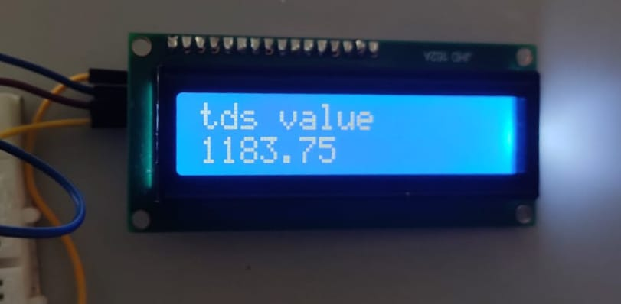
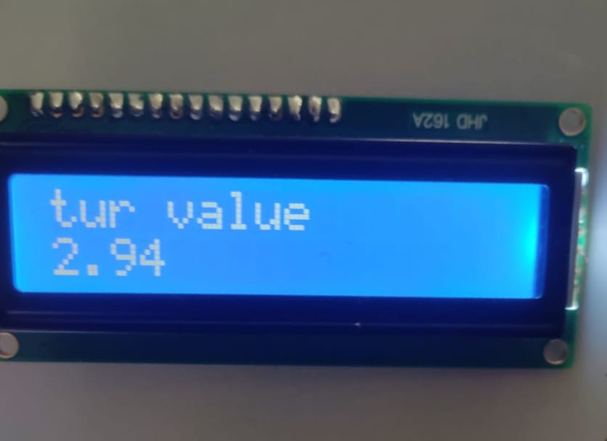
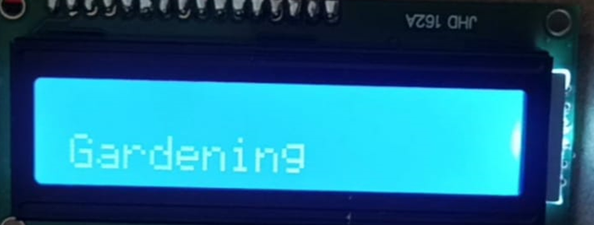
Result:

Slide 19
Conclusion
The project successfully developed a system for quality monitoring of recycled wastewater using TDS, turbidity, and pH sensors with data displayed on an LCD screen. The objectives of the project were achieved, including the design and construction of a reliable monitoring system, development of a user-friendly interface, implementation of calibration techniques, validation of sensor performance, and assessment of feasibility for continuous monitoring in various applications.

Slide 20
Reference
[1] Kumar, Manish, Tinku Singh, Manish Kumar Maurya, Anubhav Shivhare, Ashwin Raut, and Pramod Kumar Singh. "Quality Assessment and Monitoring of River Water Using IoT Infrastructure." IEEE Internet of Things Journal (2023).
[2] M. Kumar, T. Singh, M. K. Maurya, A. Shivhare, A. Raut and P. K. Singh, "Quality Assessment and Monitoring of River Water Using IoT Infrastructure," in IEEE Internet of Things Journal, doi: 10.1109/JIOT.2023.3238123.
[3] B. Suwandi et al., "Development of a Low-Cost TDS Sensor Using an Electric Plug with The Curve Fitting Method Approaches," 2022 International Conference on Radar, Antenna, Microwave, Electronics, and Telecommunications (ICRAMET), Bandung, Indonesia, 2022, pp. 83-87, doi: 10.1109/ICRAMET56917.2022.9991206.
[4] Q. Song, F. Luan, Z. Shi, T. Li and M. Wang, "Design of Turbidity Remote Monitoring System Based on FX-11A Optical Fiber Sensor," 2020 Prognostics and Health Management Conference (PHM-Besançon), Besancon, France, 2020, pp. 291-294, doi: 10.1109/PHM-Besancon49106.2020.00056.
[5] J. Yin, W. Chen, W. Gao, X. Zhang, B. Tang and Q. Jin, "Batch Fabrication of Microminiaturized pH Sensor Integrated With IrOx Film and Solid State Ag/AgCl Electrode for Tap Water Quality Online Detection," in IEEE Sensors Journal, vol. 23, no. 4, pp. 3475-3484, 15 Feb.15, 2023, doi: 10.1109/JSEN.2023.3234140.

Slide 21
Reference
[6]D. Parida, A. Behera, J. K. Naik, S. Pattanaik and R. S. Nanda, "Real-time Environment Monitoring System using ESP8266 and ThingSpeak on Internet of Things Platform," 2019 International Conference on Intelligent Computing and Control Systems (ICCS), Madurai, India, 2019, pp. 225-229, doi: 10.1109/ICCS45141.2019.9065451.
[7]Kalirajan, K., Nambiar, M.V., Vinodhini, K. and Ramya, E., 2021, May. IOT based industrial waste water monitoring and recycling. In Journal of Physics: Conference Series (Vol. 1916, No. 1, p. 012119). IOP Publishing.
[8]W. -J. Li, C. Yen, Y. -S. Lin, S. -C. Tung and S. Huang, "JustIoT Internet of Things based on the Firebase real-time database," 2018 IEEE International Conference on Smart Manufacturing, Industrial & Logistics Engineering (SMILE), Hsinchu, Taiwan, 2018, pp. 43-47, doi: 10.1109/SMILE.2018.8353979.

Slide 22
THANK YOU ​

